Slide 1
Octree-Based Decimation of Marching Cubes Surface (1996)
Raj Shekhar
Elias Fayyad
Roni Yagel
J. Fredrick Cornhill

Slide 2
Introduction
The Marching Cubes (MC) algorithm has been the most popular one in generating high-quality surface representation.
There is a trade-off between surface detail and rendering speed.
  Example: downsample

Slide 3
Introduction
The proposed decimation algorithm uses adaptive downsampling as way to reduce the rumber of surface primitives.
  Enhance the performance of the renderer
  Real time
It downsamples the volume dataset where the isosurface is mostly flat and maintains high resolution in parts with finer details.
  Octree

Slide 4
Introduction
The algorithm approximates the surface with large triangles at low frequency regions and small triangles at high frequency regions.
The overall surface quality is controlled by the user through the error value.

Slide 5
Octree
The use of the octree data structure for this pupose is quite crucial.
  Root, Intermediate node, Leaf, Branch, Level
  case information, intersection points and child nodes

Slide 6
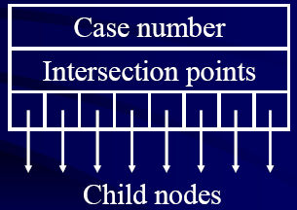
Octree
Octree node structure:

Slide 7
Octree
If the dataset is X*Y*Z in size, the depth of the octree is about the logarithm of the maximum of X, Y and Z.
The intermediate nodes, at the completion of surface tracking, do not have a valid case ( a number between 0 and 255) and intersection points.
There are many empty leaf nodes that do not have a valid case, either.

Slide 8
Octree-based decimation Algorithm
Surface Tracking
Merging of Cells
Crack Patching
Triangulation

Slide 9
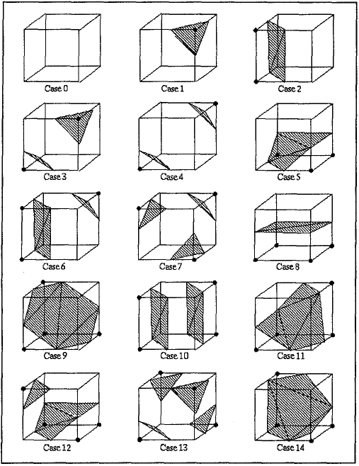
Surface Tracking
Original MC Algorithm
  Cell by cell
  15 distinct cases
  Linear interpolation
  Triangulation

Slide 10
Surface Tracking
Enhanced MC Algorithm
  Based on the following observations:
  A very complex surface within a 3D dataset pass through only a small percentage of the total cells.
    Exhaustive search of all cubes is unnecessary
  Propagation

Slide 11
Surface Tracking
Propagation
  The number of neighboring cubes to visit is either 0, 3, 4, 5 or 6.
  It must be noted that only six out of 15 distinct cases avoid visiting all the six neighboring cubes.
    Case 0 , 1 , 2 , 3 , 5 , 8
  The experience shows that these six cases account for 90% of the cases encountered in extracting an isosurface.

Slide 12
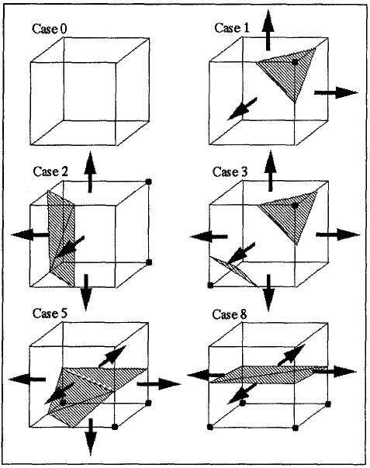
Surface Tracking

Slide 13
Surface Tracking
Propagation
  Look-up table
  FIFO queue
  3D flag array
    All the elements of the flag array are initially marked not-visited.
    The cells that are explored have their corresponding flag marked visited.

Slide 14
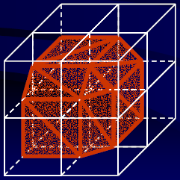
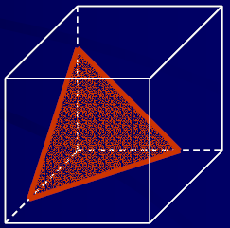
Merging of Cells

Slide 15
Merging of Cells
Merging is the most important component of this algorithm.
The octree is traversed level by level from bottom to top.
The child nodes under such parent nodes are evaluated to see if they can be merged together based on the merge criteria explain below.

Slide 16
Merging of Cells
Merge Criteria
  1. All the eight child cells must either be simple cases or null.
  2. If the merging failed somewhere below the current node, then no merging occurs at the current node.
  3. If the parent cell results in more than one intersection on any of its edges, merging is aborted.
  4. Ambiguity
  5. Error value

Slide 17
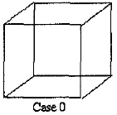
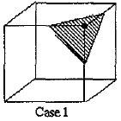
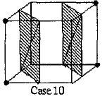
Merge Criteria
All the eight child cells must either be simple cases or null.
  A child cell is null if no surface passes through it.
    Example: Case 0
  A simple case is one in which the cell has only one connected surface.
    Example: Case 1, 2, 5, 8, 9, 11, 14

Slide 18
Merge Criteria
If the merging failed somewhere below the current node, then no merging occurs at the current node.

Slide 19
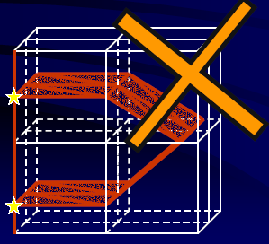
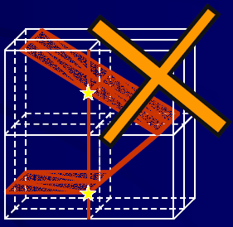
Merge Criteria
If the parent cell results in more than one intersection on any of its edges, merging is aborted.

Slide 20
Merge Criteria
If the case may result in two edges on at least one face of the parent cell.
  Having two edges causes ambiguity in the patching algorithm.
+
+
Case 6
Case 3
+
+

Slide 21
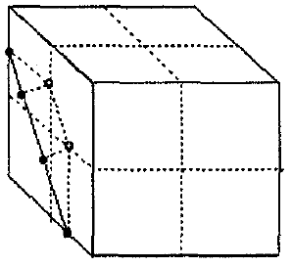
Merge Criteria
The last criterion is to test if the error due to merging is with a user-specified limit.
  If the maximum of such perpendicular distance is not greater than the permissible error, merging is allowed.

Slide 22
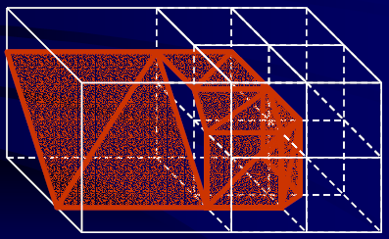
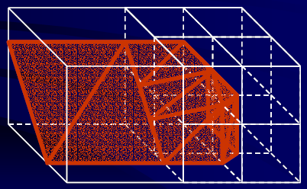
Crack Patching Strategy

Slide 23
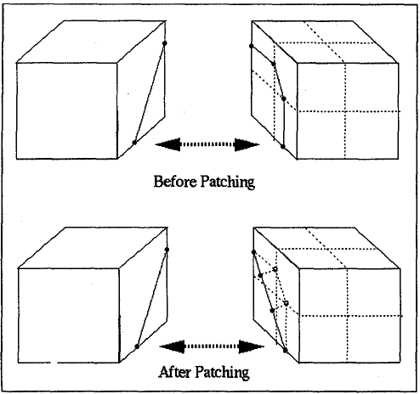
Crack Patching Strategy
Cracks are generated at the interfaces of cells with differing dimensions.
This is a common problem with adaptive subdivision algorithm.

Slide 24
Crack Patching Strategy
Patching is accomplished by stretching the high-resolution edge to match with the low-resolution edge.
low-resolution
High-resolution

Slide 25
Crack Patching Strategy
The major steps in patching are the following :
  1. Traverse the octree in a breadth-first manner.
  2. If a node with a valid case is encountered, patching is applied to its 6-connected neighboring cells at the same level of the octree.

Slide 26
Crack Patching Strategy
  3. If the neighbor cell does not exist, the current cell is either on the edge of the dataset or is a neighbor of a larger cell.
  4. If the neighbor cell exists and has a valid case, the neighbor is a cell of the same dimension. There is no chance of having a crak problem.

Slide 27
Crack Patching Strategy
  5. If the neighboring cell has child cells below it, then the child cells have an edge on the common interface with the current cell.
  The end points of that edge are moved to fall on the low resolution edge.
  6. Patching stops when the breadth-first traversal stops.

Slide 28
Triangulation
The last step is to output the surface by triangulation.
Forming the surface, therefore, requires identifying such nodes and outputting their intersection points following the triangulation scheme of the MC algorithm.

Slide 29
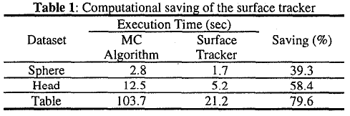
Results
The following three datasets were used for this work.
  1) 64*64*64 Sphere dataset
  2) 128*128*128 MRI head dataset
  3) 256*256*256 Table dataset

Slide 30
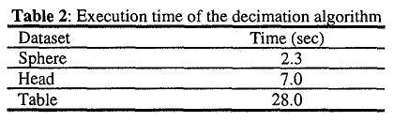
Results
This table shows the execution time of the complete algorithm for the three datasets at an error value of 0.5
  The execution time is directly related to the size of the dataset.

Slide 31
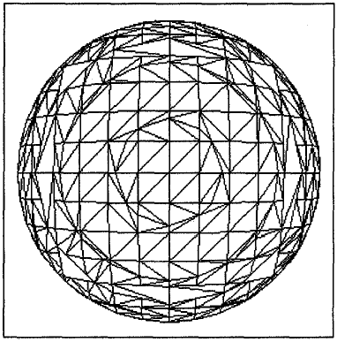
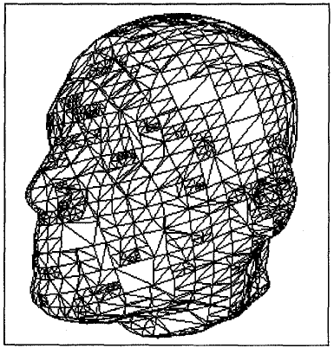
Results
Wiremesh models of the sphere and head datasets at an error value of 0.5

Slide 32
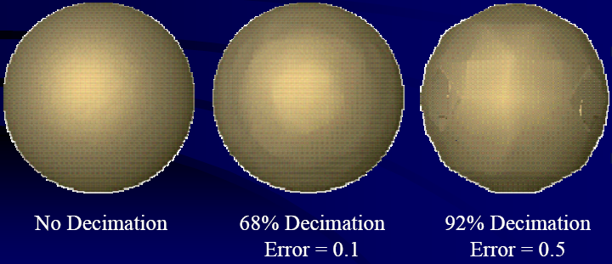
Results
Sphere dataset

Slide 33
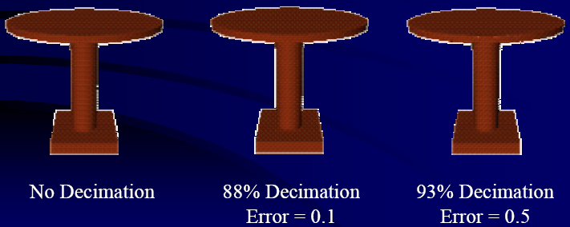
Results
Table dataset

Slide 34
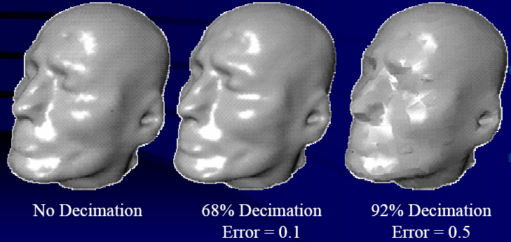
Results
MRI head dataset

Slide 35
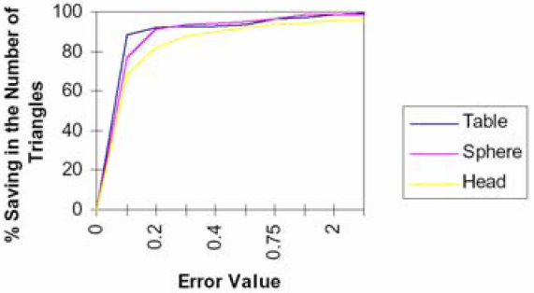
Results
Percent saving in the number of triangles versus user-specified error value for the three datasets.

